Slide 1
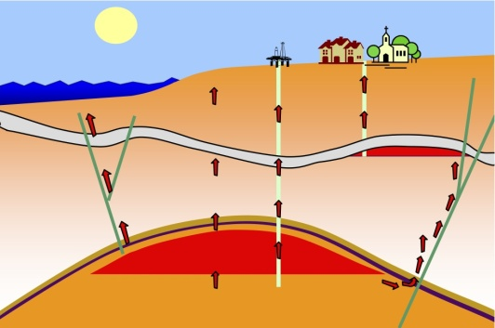
CORA engine QuickBlocks
Subsidence
Leakage along wells
Leakage through the cap rock
Leakage along fault planes
Lateral Migration:
F. Kraaijeveld PTI/RC
Geomechanicist

Slide 2
Quickblocks setup model
  All components need to be added upfront. No update possible.
  Model setup:
    To generate input form
      Choose template or model (filename will be asked after “Generate input form”)
      Choose component input forms
      Choose name output folder (will be created at level of Excel sheet)
      Generate input form (and choose model)
    Fill in base case, including component details
    Fill in uncertainties
    Set up correlation matrix
    Validate & continue
  You can select and deselect uncertainties & components
  Always validate after a change

Slide 3
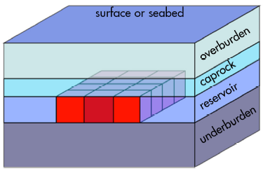
Quickblocks features
Input model
  via template (4 layers, dP): basecase + uncertainties
  QB 2.* model: only uncertainties. Note that even if mean distribution is not equal to basecase value, the mean is used.
  Settings sheet to set path to EPD & QB

Slide 4
QuickBlocks limitations in cora
  Template
  4 Horizontal layers
  Only pressure depletion, temperature changes not supported
  Models QuickBlocks version 2.*
  Formations with constant depths (not arrays or pointset due to identification of (failure) material contrasts), incl surfacedepth.constant
  Only parameters that are a Real are allowed to have uncertainty assigned
  Failure modes
  Failure area = sum failed points times grid size (irrespective thickness layer)
  Fault is a plane
  Formation is a volume
  Well is a line
  Subsidence always at surfacedepth (not yet validated in GUI)

Slide 5
CORA QB IO workflow
Model
  This holds for each calculation case
  Objective
    Input: interfacing ascii file with settings and parameters
    Output: QB inputfile, results file and/or single LSV per case
  Architecture:
    QBcreatecase.py:
    Transfers case ascii file to QB input file by updating properties for a known model, including output properties (pointset, depths, propout).
    QBruncase.py:
    Runs QB core with created file using settings in ascii file in multiprocessing or normal mode
    Currently VBA Possibly: QBevalcase.py (being replaced by more general code): Calculate LSV based on resistance and QB results
=
Pre-processing
QuickBlocks
Post-processing

Slide 6
Formations
Failure modes
  Shear failure (SCU from principal stresses)
  Tensile failure (min principal stress)
  Later: Pore collapse (max principal stress)
  Compression failure (max principal strain)
  Extension failure (min principal strain)
  Compaction failure (max Ez)
  Later: Elongation failure (min Ez)
Types
  Volume G
  Gridplanes
  Formation name
  Note: only gridplanes rotates volume with blocks (blocks.angle <>0)

Slide 7
Faults
Failure modes
  Shear failure (rotated stresses for full element set)
Types
  Template
  GoCad file (.mx)

Slide 8
Wells
Failure modes
  Later: Shear failure (see formation)
  Later: Tensile failure (see formation)
  Axial compression
  Axial extension
Types
  Template
  Not tested: 3D pointset file

Slide 9
Subsidence
Failure modes
  Subsidence
  Later: Upheave
Type
  Gridplane @ surface
  Later: pointset @ surface

Slide 10
Background information QuickBlocks PRE- & post-processing

Slide 11

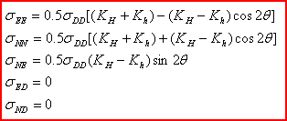
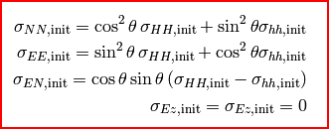
In situ stress
S_{v},S_{H},S_{h} to S_{NN},S_{EE},S_{DD} system
S_{v} = S_{DD}
S_{EE} = 0.5[(S_{H} + S_{h} )-(S_{H} - S_{h} )cos(2azi)]
S_{NN} = 0.5[(S_{H} + S_{h} )+(S_{H} - S_{h} )cos(2azi)]
S_{EE} = 0.5(S_{H} - S_{h} )sin(2azi)
N,y
S_{h}
azi
S_{H}
E,x

Slide 12

Component definitions in Qbmodi (1)
widthN
N,y
widthE
height
E,x
D,z
Formation
Template volume (see picture; segH,segV view discretization; sample for calculation depths)
Template gridplane (view points + depths)
Name (of formation/layer; segH,segV view discretization; sample for calculation depths)

Slide 13
Component definitions in Qbmodi (2)
N,y
azi
N,y
azi
width
dip
E,x
E,x
dip
height
D,z
D,z
Well
The azimuth is angle from Northing clockwise
The dip is angle with vertical anticlockwise
Fault
The azimuth is direction ball rolls, wrt Northing
The dip is the angle with horizontal, clockwise

Slide 14
Well path
N,y
azi
E,x
dip
D,z

Slide 15
Fault planE
azi
N,y
Center point
  HeartE = Egrid.min()+(Egrid.max()-Egrid.min())/2.
  HeartN = Ngrid.min()+(Ngrid.max()-Ngrid.min())/2.
  HeartD = Dgrid.min()+(Dgrid.max()-Dgrid.min())/2.
Vectors
  Normal = [np.sin(dip)*np.cos(azi), np.sin(dip)*np.sin(azi), -np.cos(dip)]
  Shear = [np.cos(dip)*np.cos(azi), np.cos(dip)*np.sin(azi), np.sin(dip)]
  Strike = [-np.sin(azi), np.cos(azi), 0]
width
dip
E,x
height
D,z

Slide 16
Workflow Fault evaluation
Failure mechanism: Fault SCU
Input: fault shape, fault cohesion, fault friction angle
Output: SCU ave, SCU max, SCU area m^2, SCU area %
GoCad file
QB psfile
VBA
n,t per segment
Intermediate file
Template
CORA
C#
SCU ave and max
QB input file
python
QB psfile
QB results file
GoCad file

